Slide 1
FIRST CONDITIONAL

Slide 2
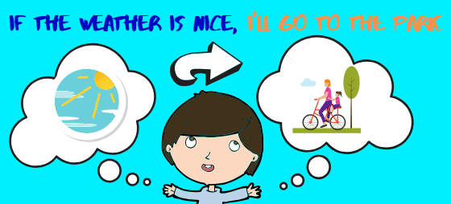
To talk about real situations or results that depend on a condition

Slide 3
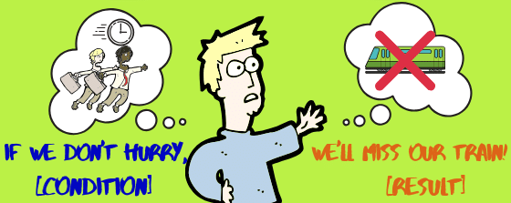
It is also used for warnings

Slide 4
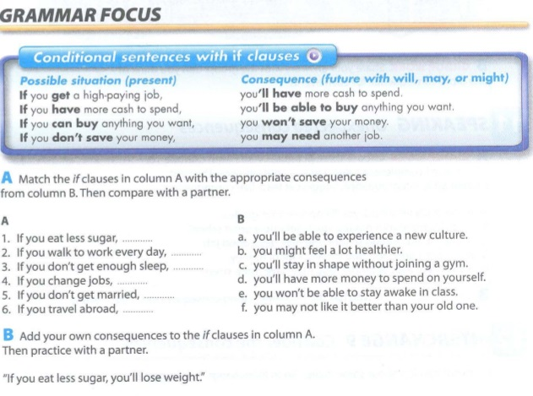
CONDITION (real situation) + RESULT (real consequence)
If I am organized, I will be prepared for the test
If I am not organized, I won’t be prepared for the test

Slide 5
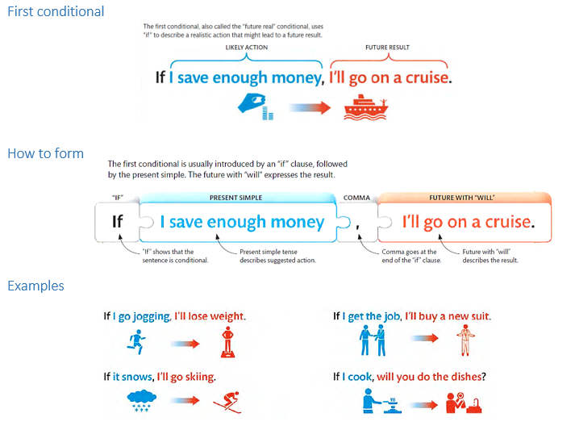

Slide 7
Create your own consequences
you won’t have cavities
I will be happy
I will practice my English

Slide 8
IF CLAUSE (PRESENT SIMPLE ) CONSEQUENCE (WILL-MAY-WON’T)
If you _AREN’T (ARE NOT)__(not be) healthy enough, you _WON’T BE ABLE TO_(not be able to) participate in the marathon.
To be = present simple AM- IS - ARE

Slide 9
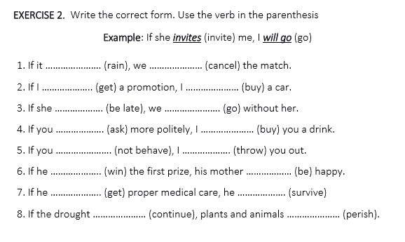

Slide 10
